Slide 1

A Minor Project on Student’s performance analysis
2
+
ATAL BIHARI VAJPAYEE UNIVERSITY
Department of Computer Science And Application (U.T.D.)
2
+
Head of Department :
DR. H. S. HOTA
Under Guidance Of :
Prof. jeetendra gUpta
Prof. Shriya Sahu
Submitted By :
Sandeep Girepunje
Tushar Kashyap
Thanendra Kashyap
B.Sc. CSA 6th Semester
Session 2019-2020

Slide 2


Content :
2
+
2
+
2
+
Introduction
Purpose
Objective
Benefits
Requirements
Technology Used
Data Table
ER Diagram
Data Flow Diagram
Snapshots

Slide 3

Introduction :
2
+
Any website or software is created so that we can make our work easier by using It, here we have created such a website, where the student can know some information such as name, email id, date of birth etc. by knowing his /her week point and analyzing his/her performance so that the teacher can improve that week point.
This project is to predict performance of a student based on certain attributes of the students such as his semester attendance, unit test marks, last semester exam.

Slide 4

Purpose
2
+
The purpose of Student Performance Analysis is to monitor student’s learning ability and the ability for adapting the current teaching program at university.
The Concept is, student can register himself/herself to the Student Performance Analysis program and at the end of the semester they take a survey.
Based on the survey in Student Performance Analysis we collect information from the student and with this data, we can analyse student’s performance of learning
With this program, we can see what problem student’s facing while learning, for ex. Low Attendance, Interest in subject, Focus in classes, and many other issues.
Teachers can see student’s performance statistics but can’t see the answers of student’s survey, which will be confidential for student’s privacy.

Slide 5

Objective
The main objective of this project is to analyse the performance of a student by knowing his week point and to improve his week point.
Student's learning ability can be improved by the teacher.
Teachers can understand the problems student facing while learning, and he/she could solve student’s problem.
Student can overcome his/her weakness with the help of statistics of his/her performance.
Teachers will know the reasons why students can’t focus on subjects or the reasons of student’s distraction.
This can improve the communication or interaction between student’s and teacher’s.

Slide 6

Technology Used :
2
+
2
+
This project is a web application that is developed in ASP.NET having SQL Server as database.
HTML , CSS, Javascript & ASP.NET as Front-end
C# as Back-end
SQL Server as Database

Slide 7
Requirements :
2
+
Minimum Software Requirement -:
Server Configuration :
Operating System – Windows 2000 or equivalent
Server – IIS 5.0 or above
Browser – Internet Explorer 5.0
Database – SQL Server
Client Configuration :
Operating System - Windows XP,7,8,10 or equivalent
Browser – Google Chrome 1.0 or Higher, Internet Explorer 9.0 or Higher, Apple Safari 3.0 or higher, Mozilla Firefox 2.0 or higher & Opera mini 9.0 or higher
Minimum Hardware Requirement :
Processor – 2.5 GHz
RAM – 1 GB
Hard Disk – 20 GB Free Space

Slide 8
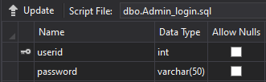
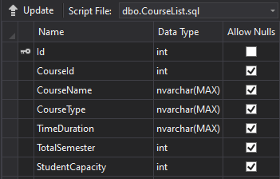
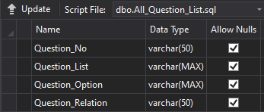
Data Table
2
+
2
+
Admin_Login Table
2
+
CourseList Table
2
+
All_Question_List Table

Slide 9
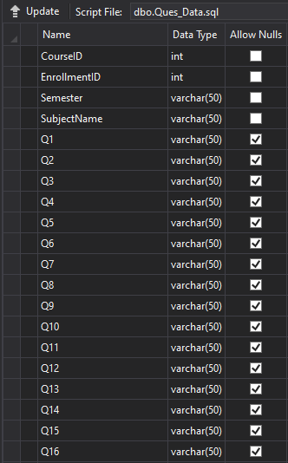
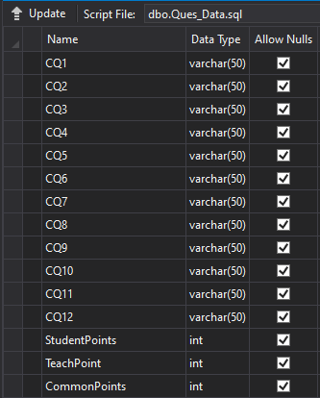
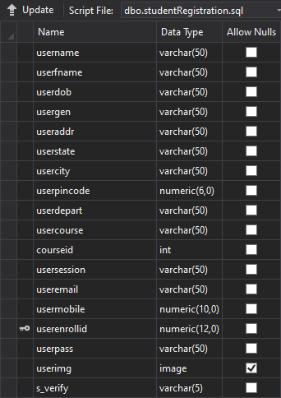
Data Table
2
+
2
+
2
+
2
+
Ques_Data Table
Ques_Data Table
studentRegistration Table

Slide 10
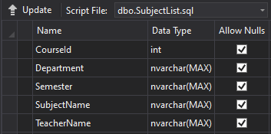
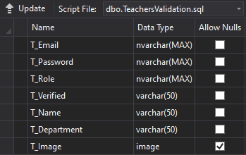
Data Table
2
+
2
+
2
+
SubjectList Table
TeachersValidation Table

Slide 11
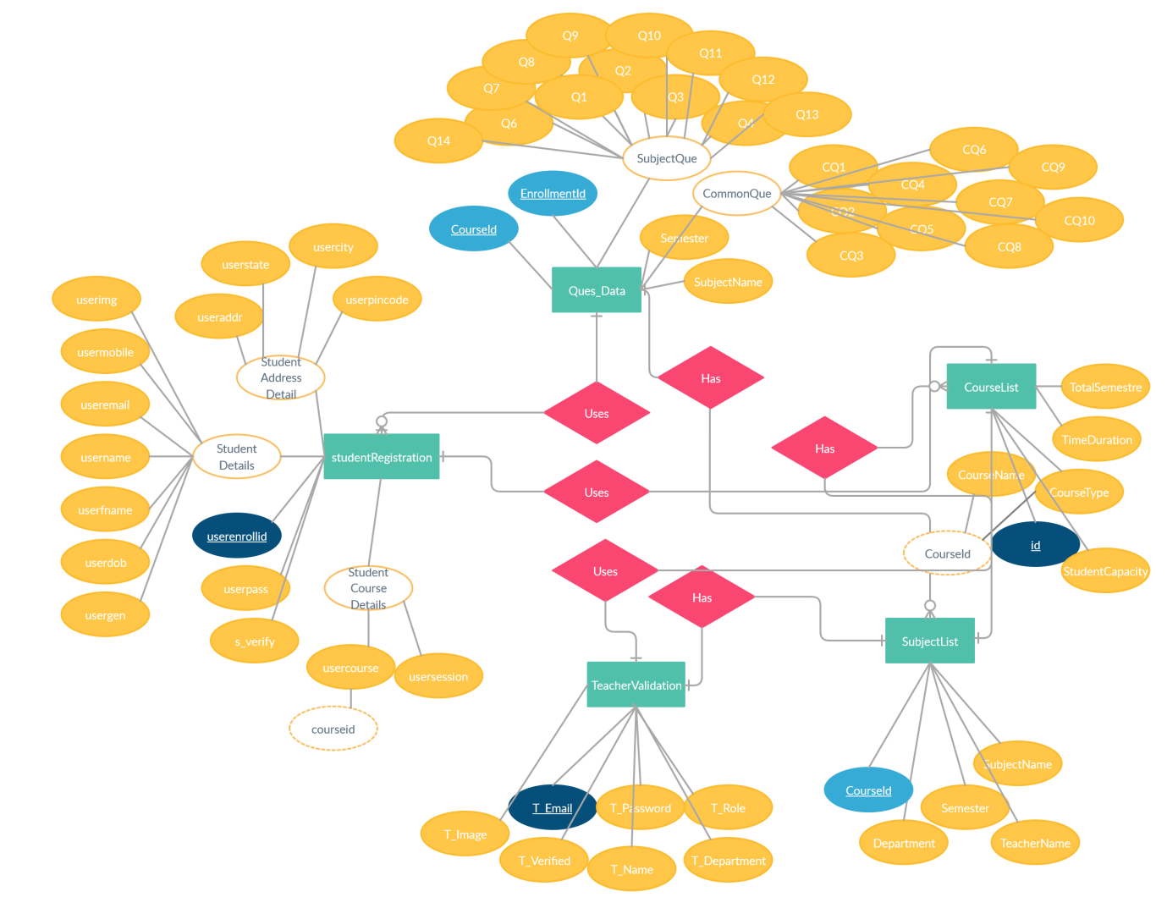
ER Diagram ( 1 )
2
+

Slide 12
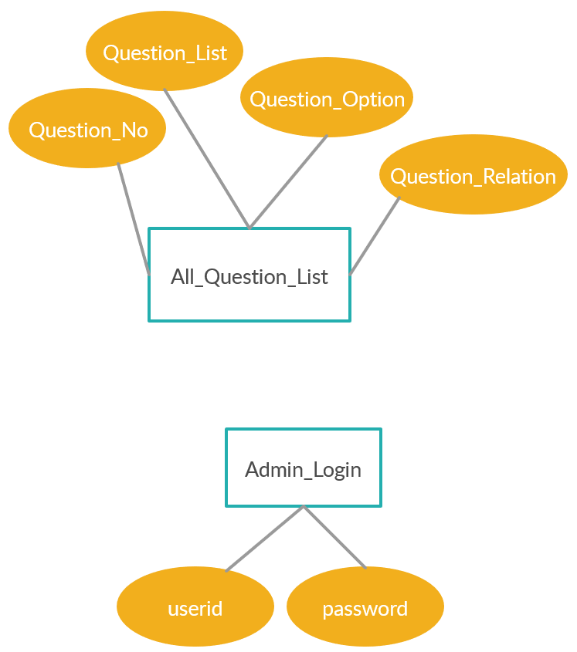
ER Diagram ( 2 )
2
+

Slide 13
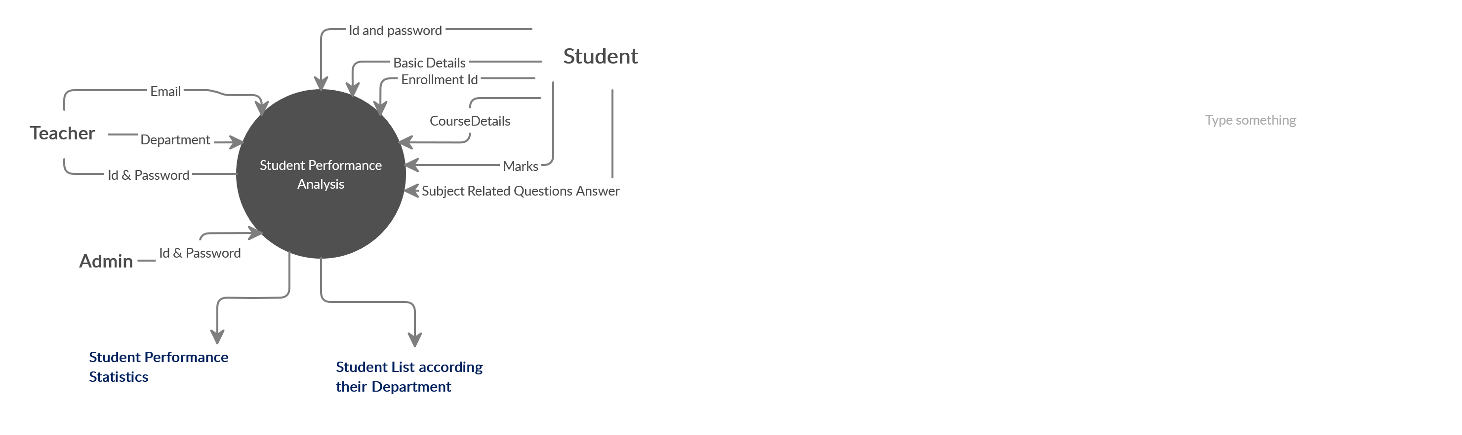
Data Flow Diagram
2
+
2
+
Level - 0

Slide 14
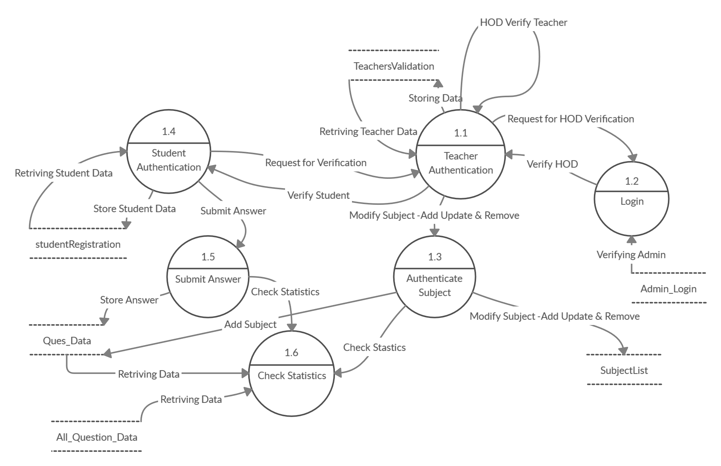
Data Flow Diagram
2
+
2
+
Level - 1

Slide 15
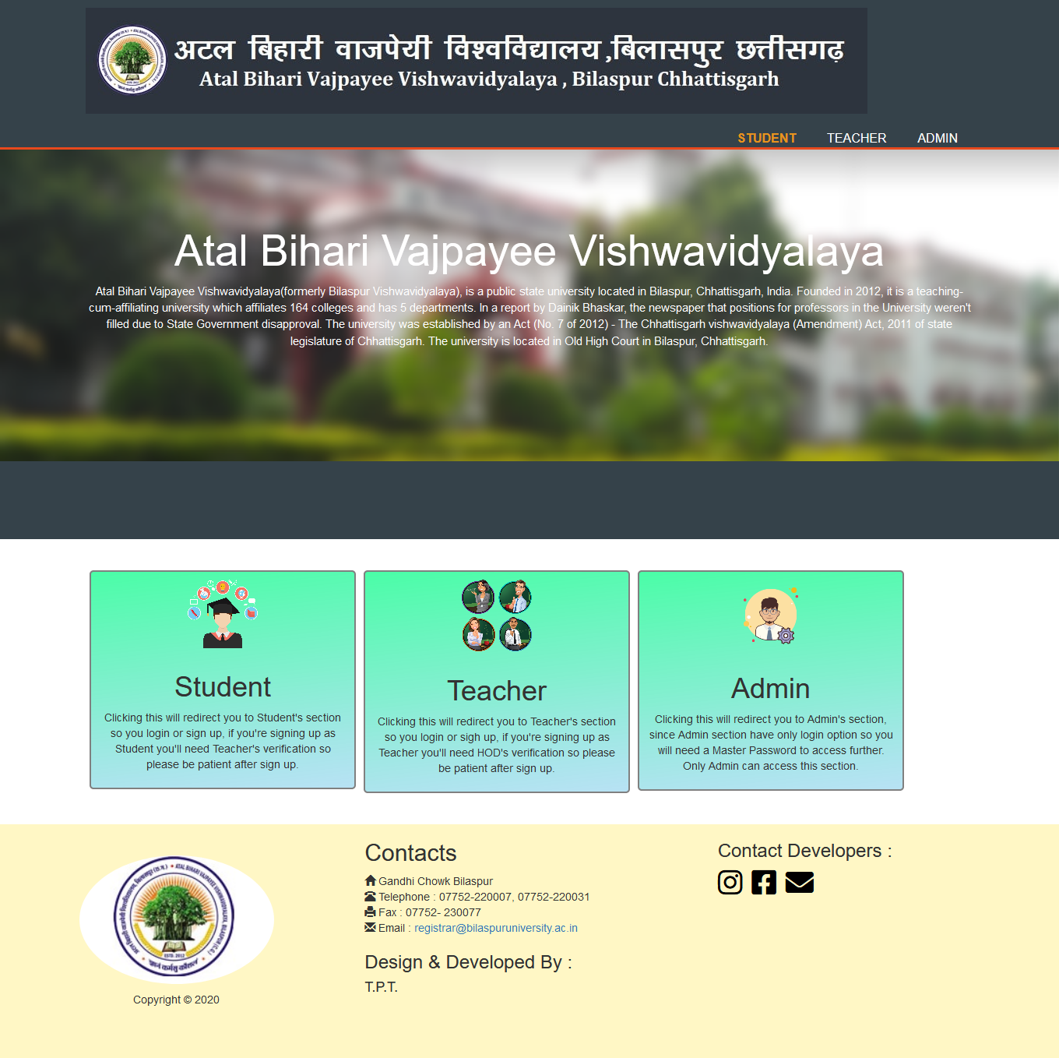

Index Page Snap Shot
2
+
2
+
2
+
Desktop View
Mobile View

Slide 16
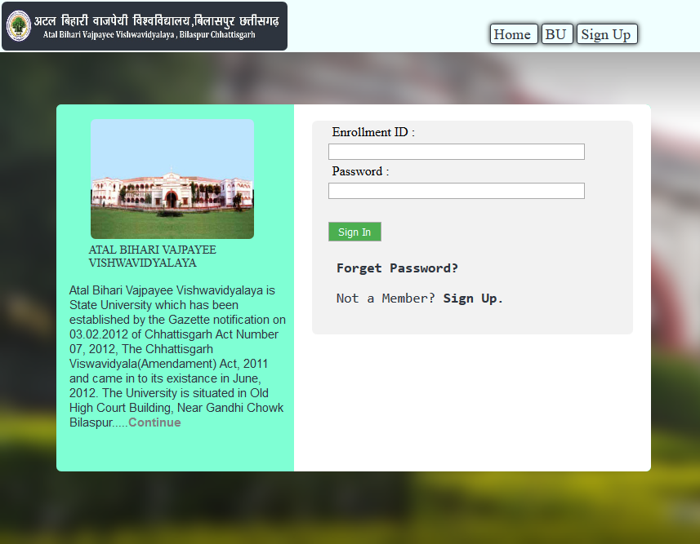
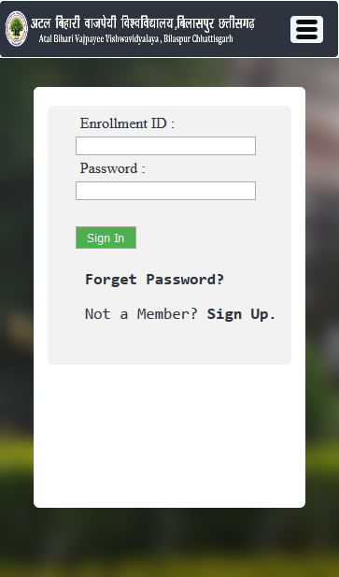
Student Login Page Snap Shot
2
+
2
+
2
+
Desktop View
Mobile View

Slide 17
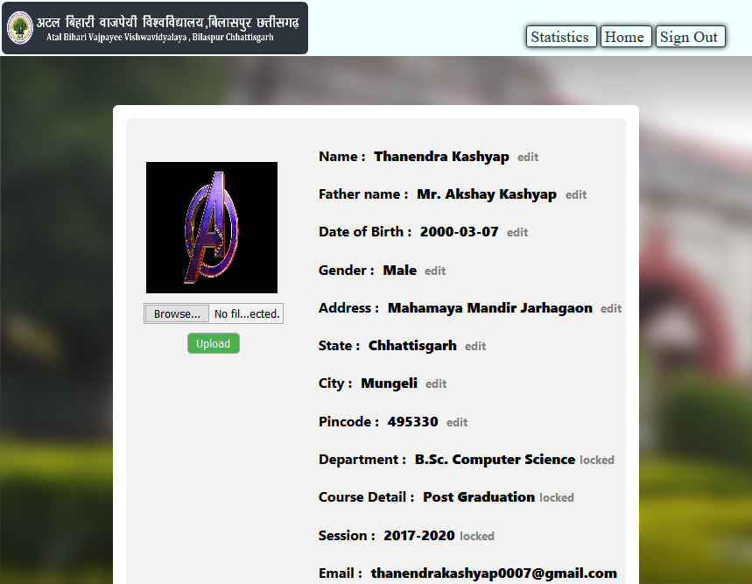
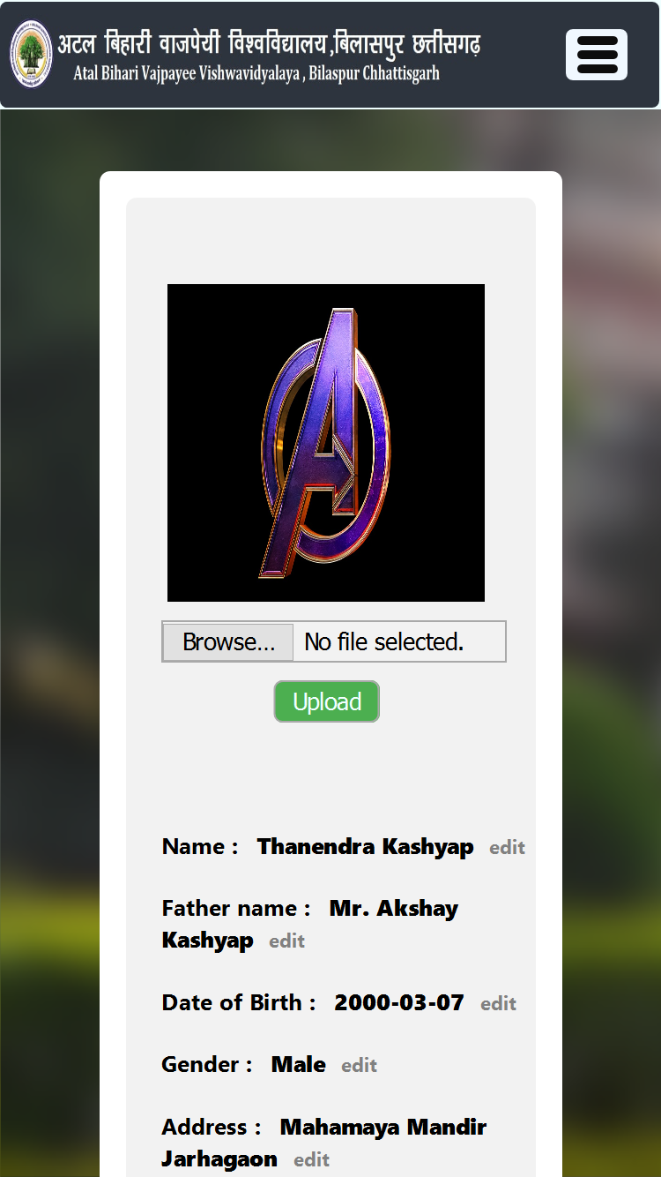
Student Profile Page Snap Shot
2
+
2
+
2
+
Desktop View
Mobile View

Slide 18
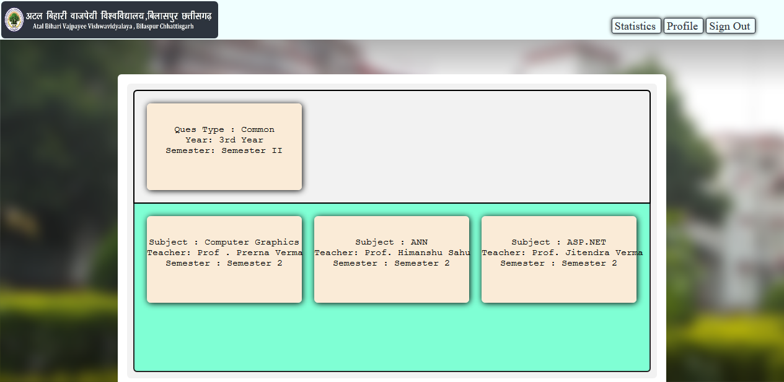
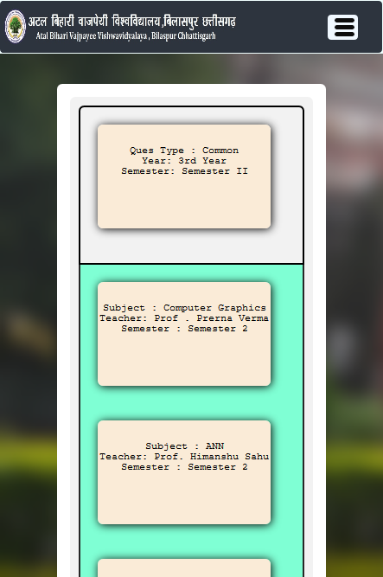
Student Home Page Snap Shot
2
+
2
+
2
+
Desktop View
Mobile View

Slide 19
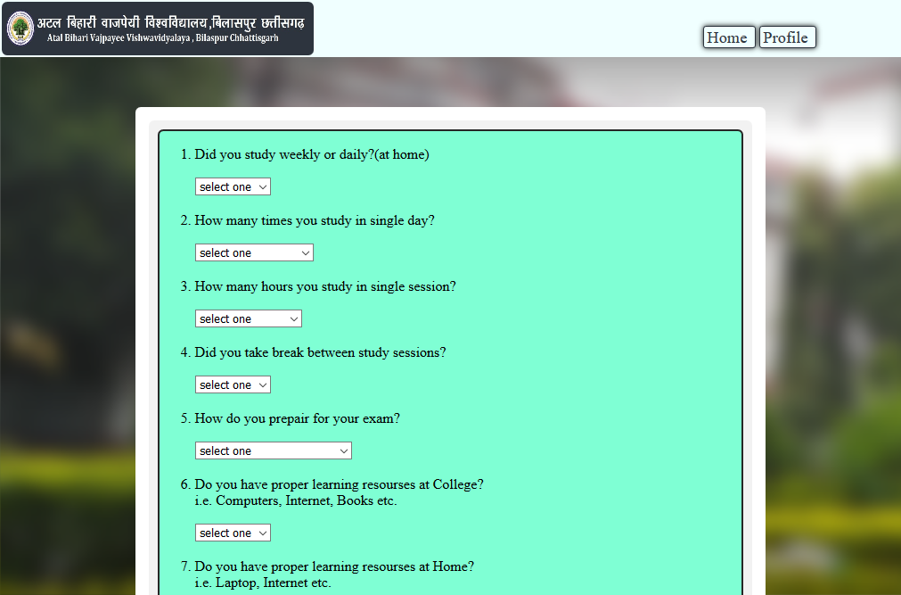
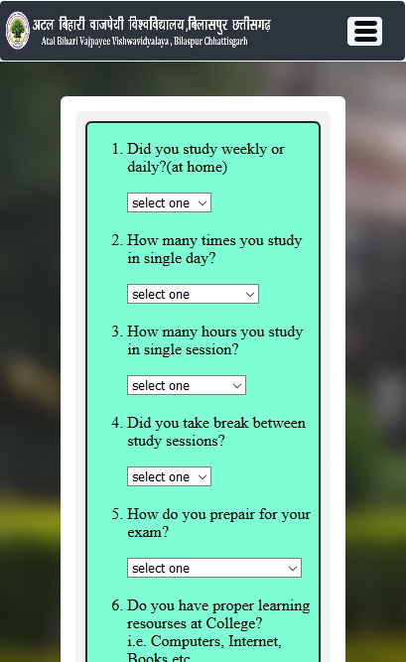
Student Questions Page Snap Shot
2
+
2
+
2
+
Desktop View
Mobile View

Slide 20
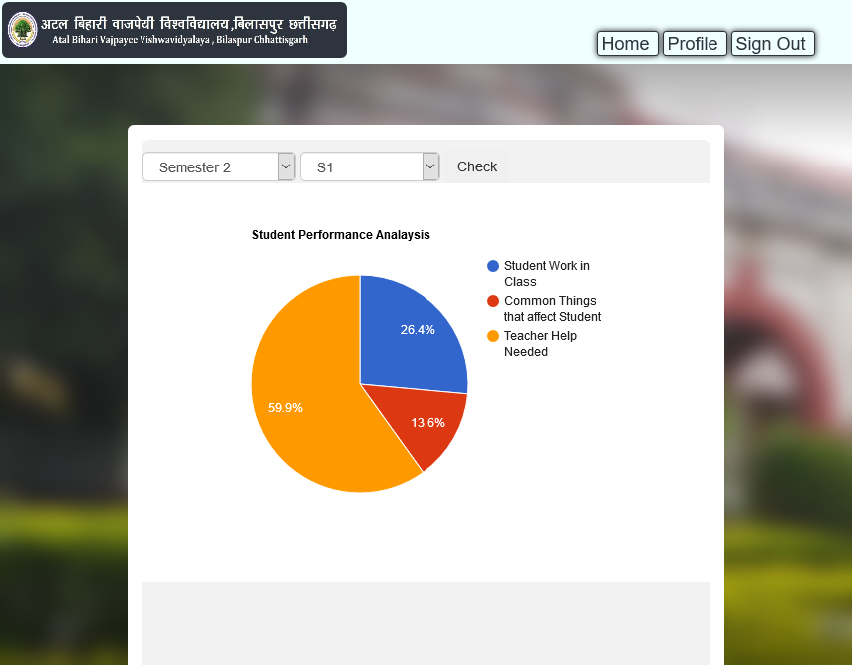
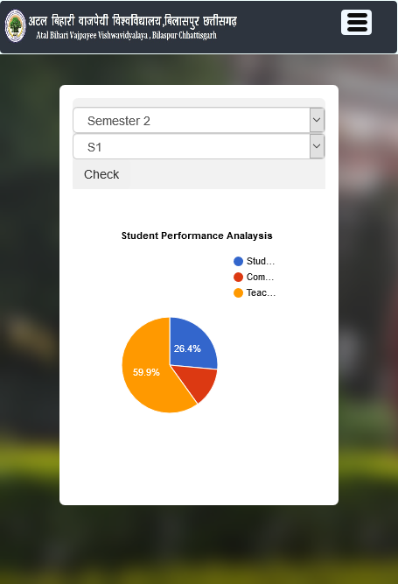
Student Statistics Page Snap Shot
2
+
2
+
2
+
Desktop View
Mobile View

Slide 21
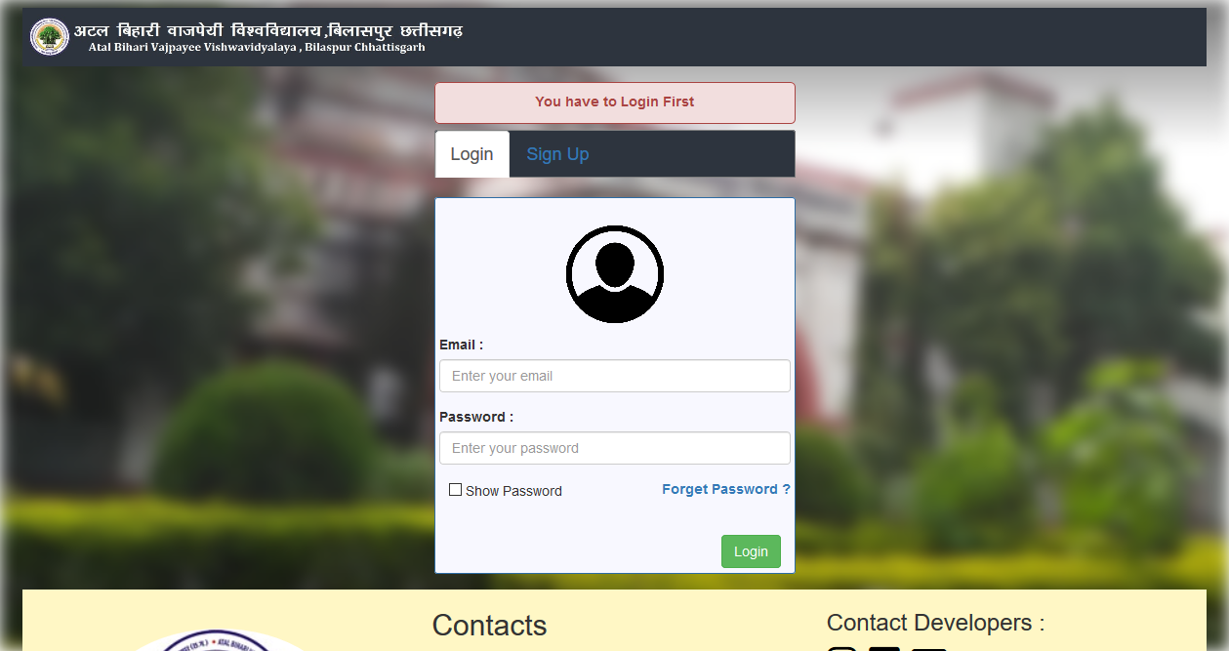
Teacher Login Page Snap Shot
2
+

Slide 22
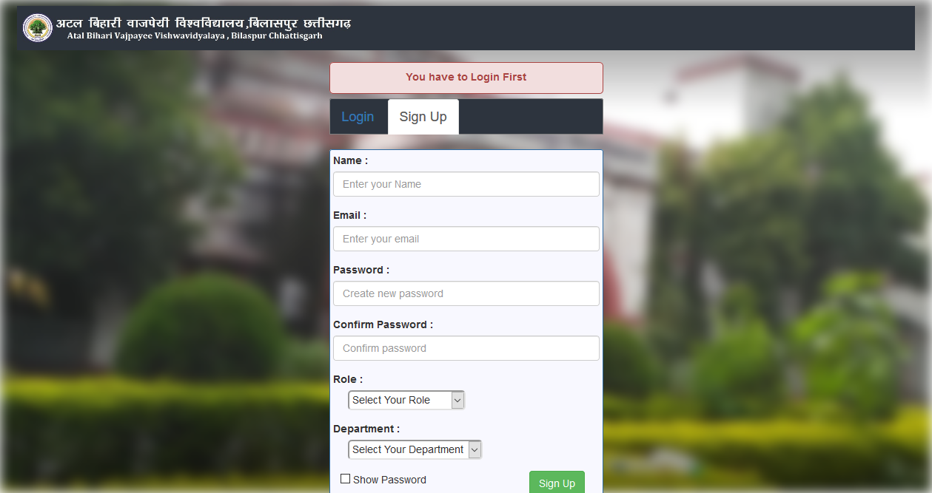
Teacher Sign Up Page Snap Shot
2
+

Slide 23
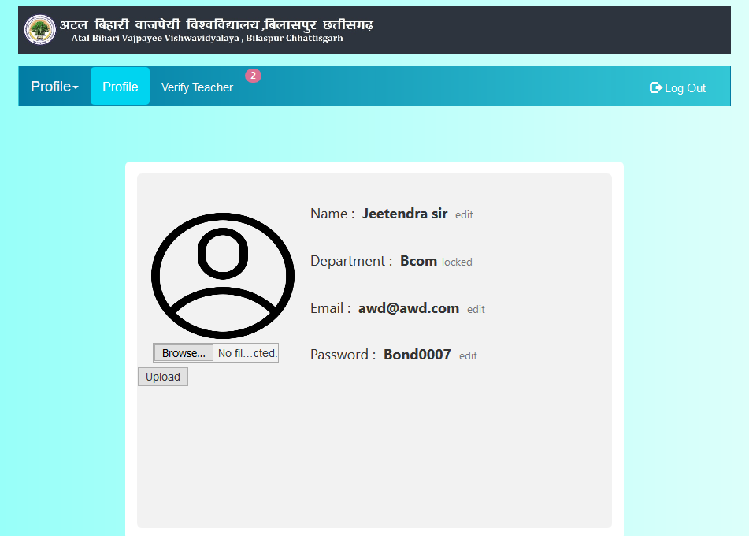
Teacher Profile Page Snap Shot
2
+

Slide 24
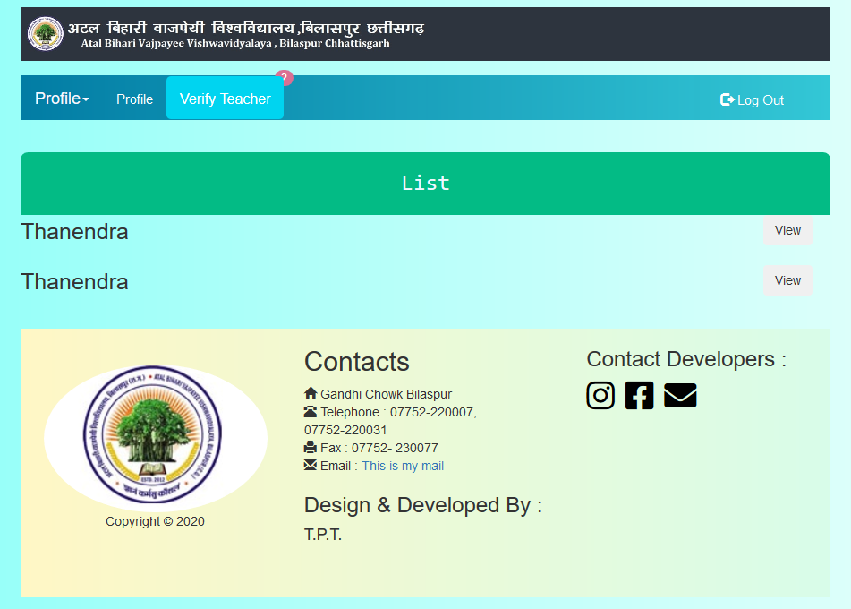
HOD Verify Teachers Page Snap Shot
2
+

Slide 25
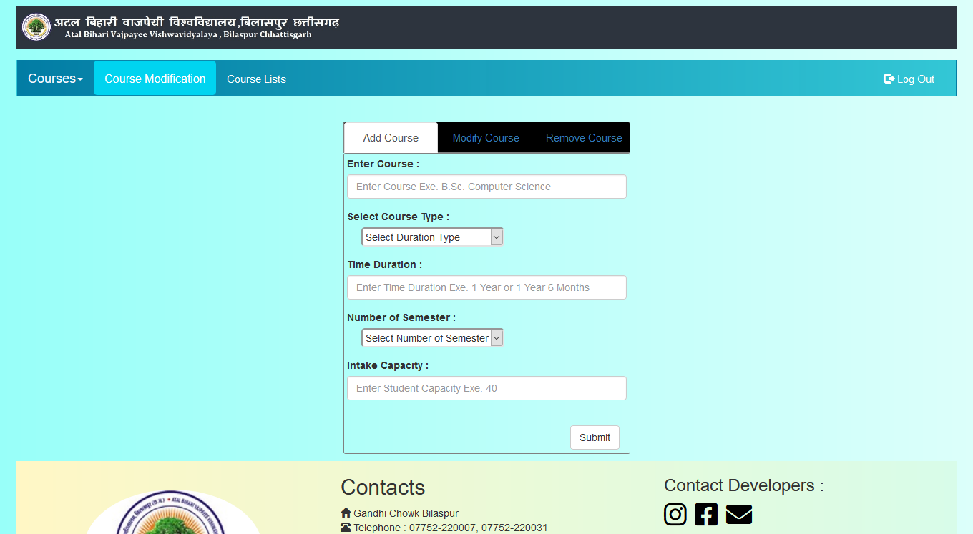
Teachers Course Modification Page Snap Shot
2
+

Slide 26
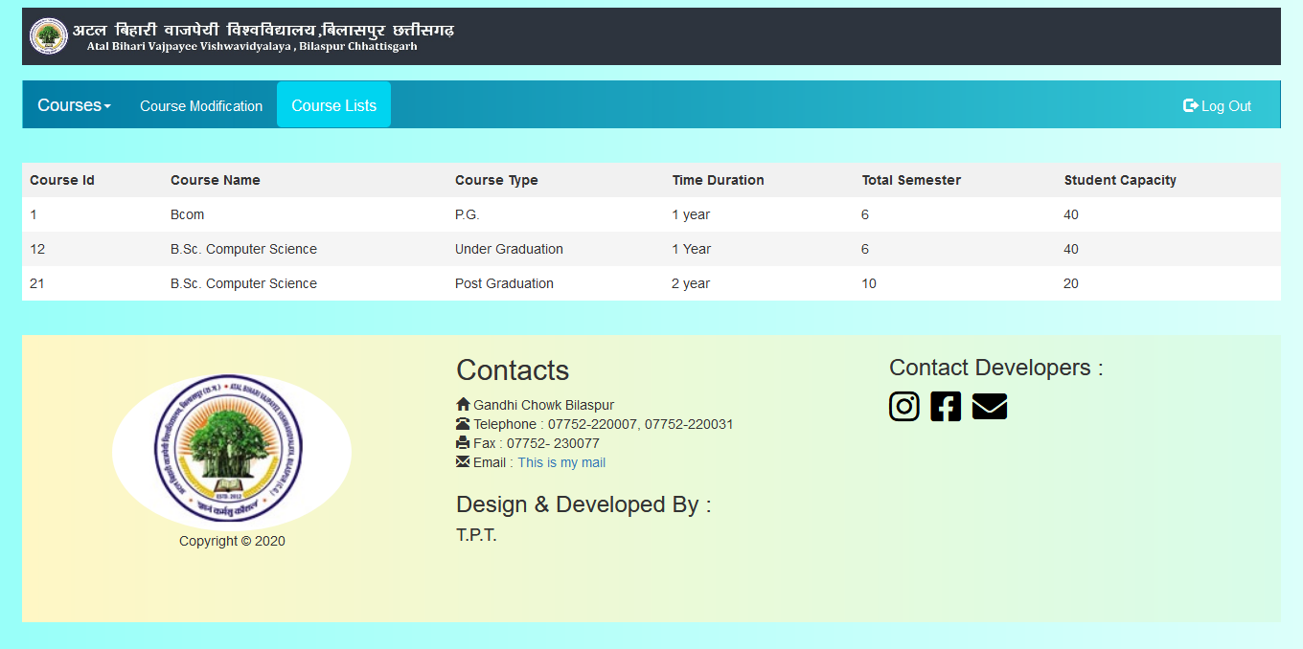
Teachers Course List Page Snap Shot
2
+

Slide 27
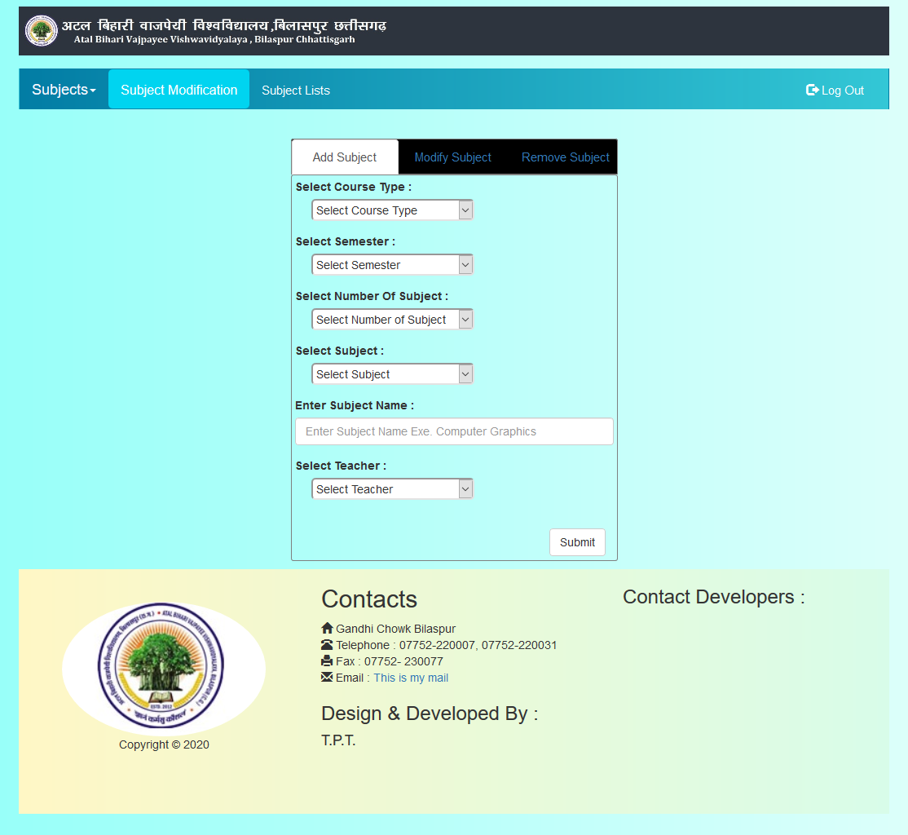
Teachers Subject Modification Page Snap Shot
2
+

Slide 28
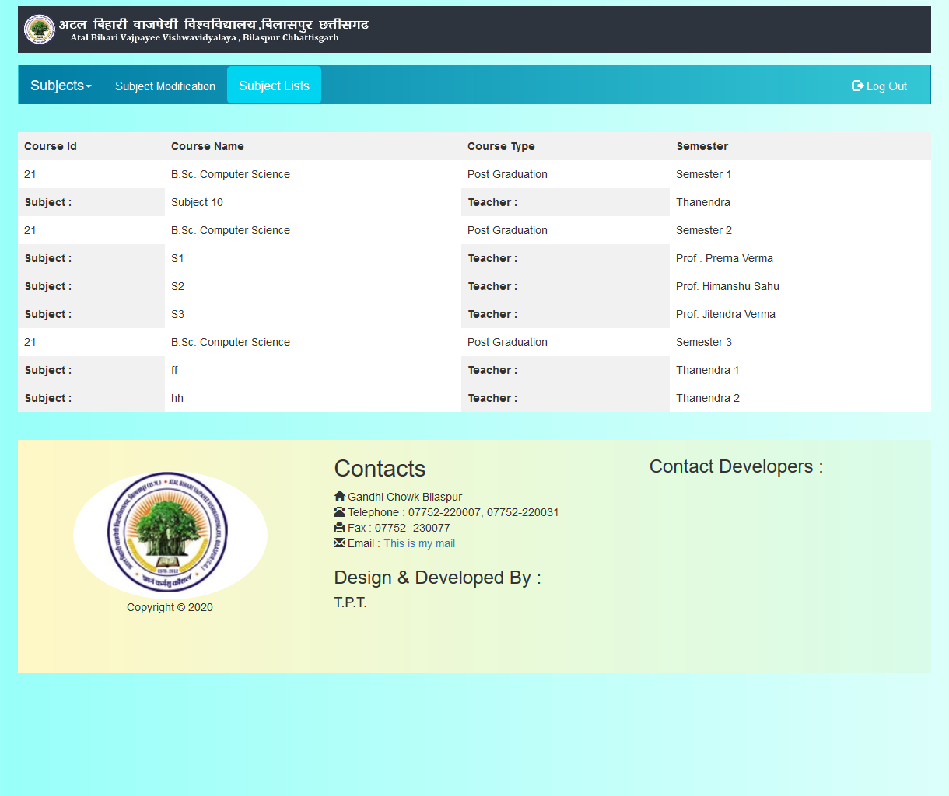
Teachers Subject List Page Snap Shot
2
+

Slide 29
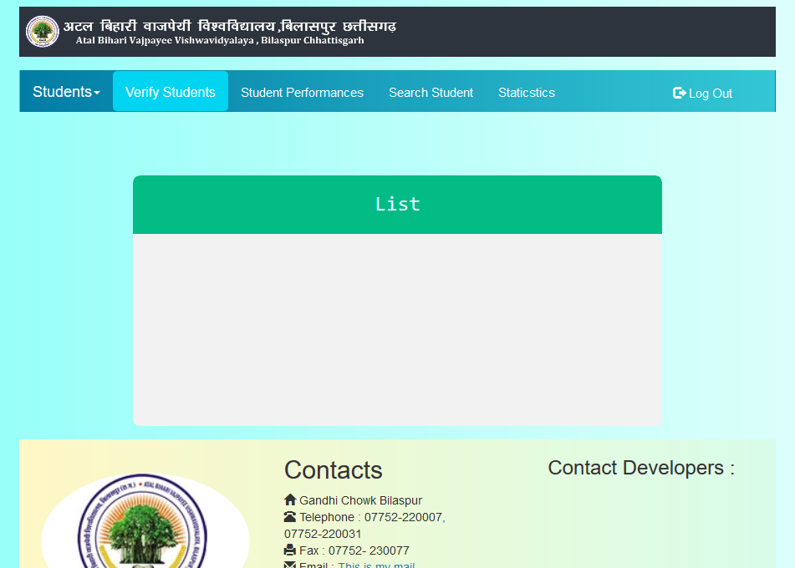
Teachers – Student Verification Page Snap Shot
2
+

Slide 30
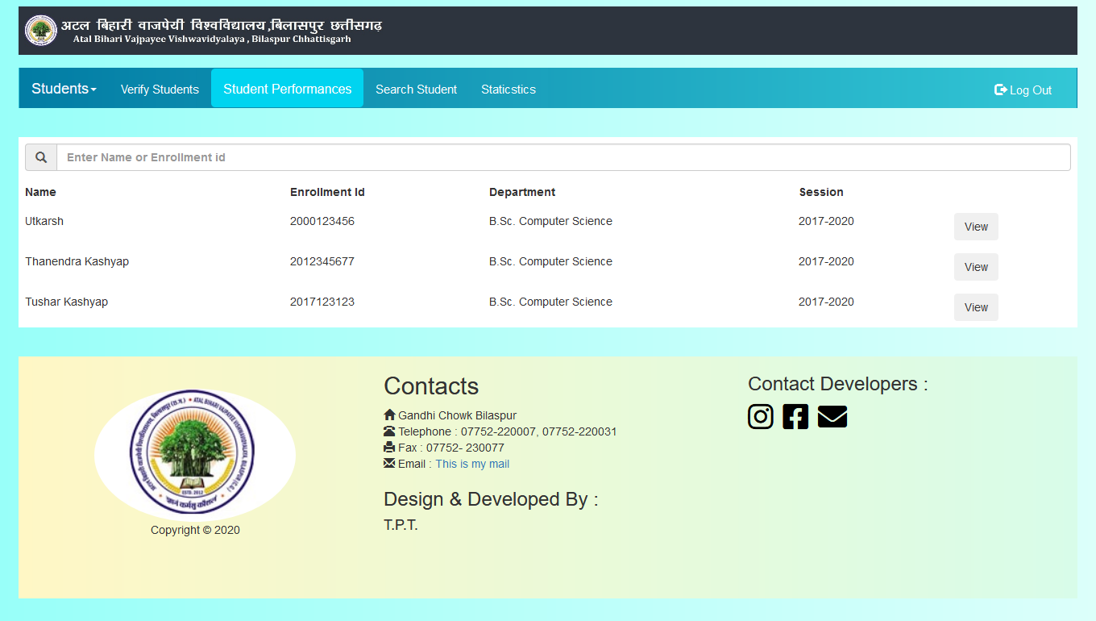
Teacher’s – Student Performance Page Snap Shot
2
+

Slide 31
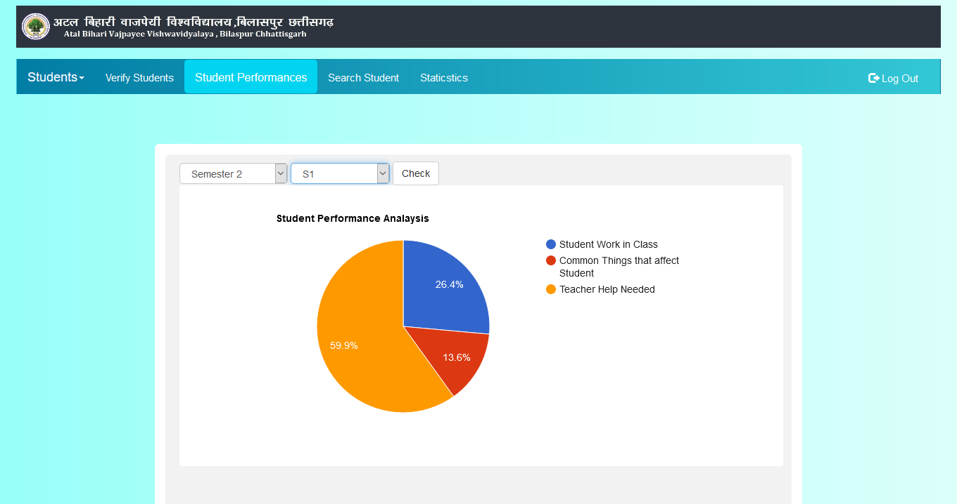
Teacher’s – Student Performance Page Snap Shot
2
+

Slide 32
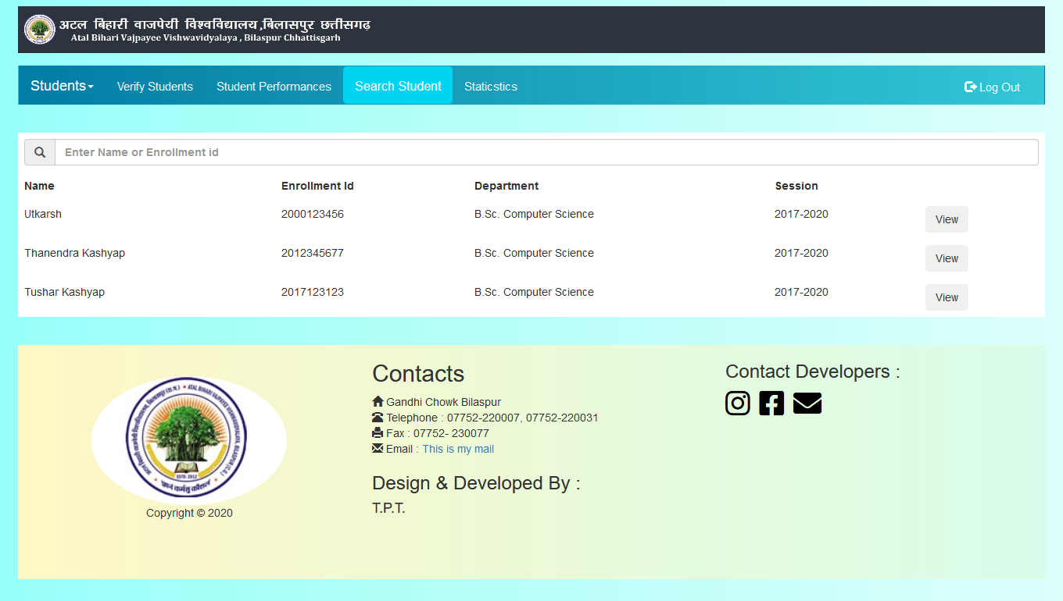
Teacher’s – Student Profile Page Snap Shot
2
+

Slide 33
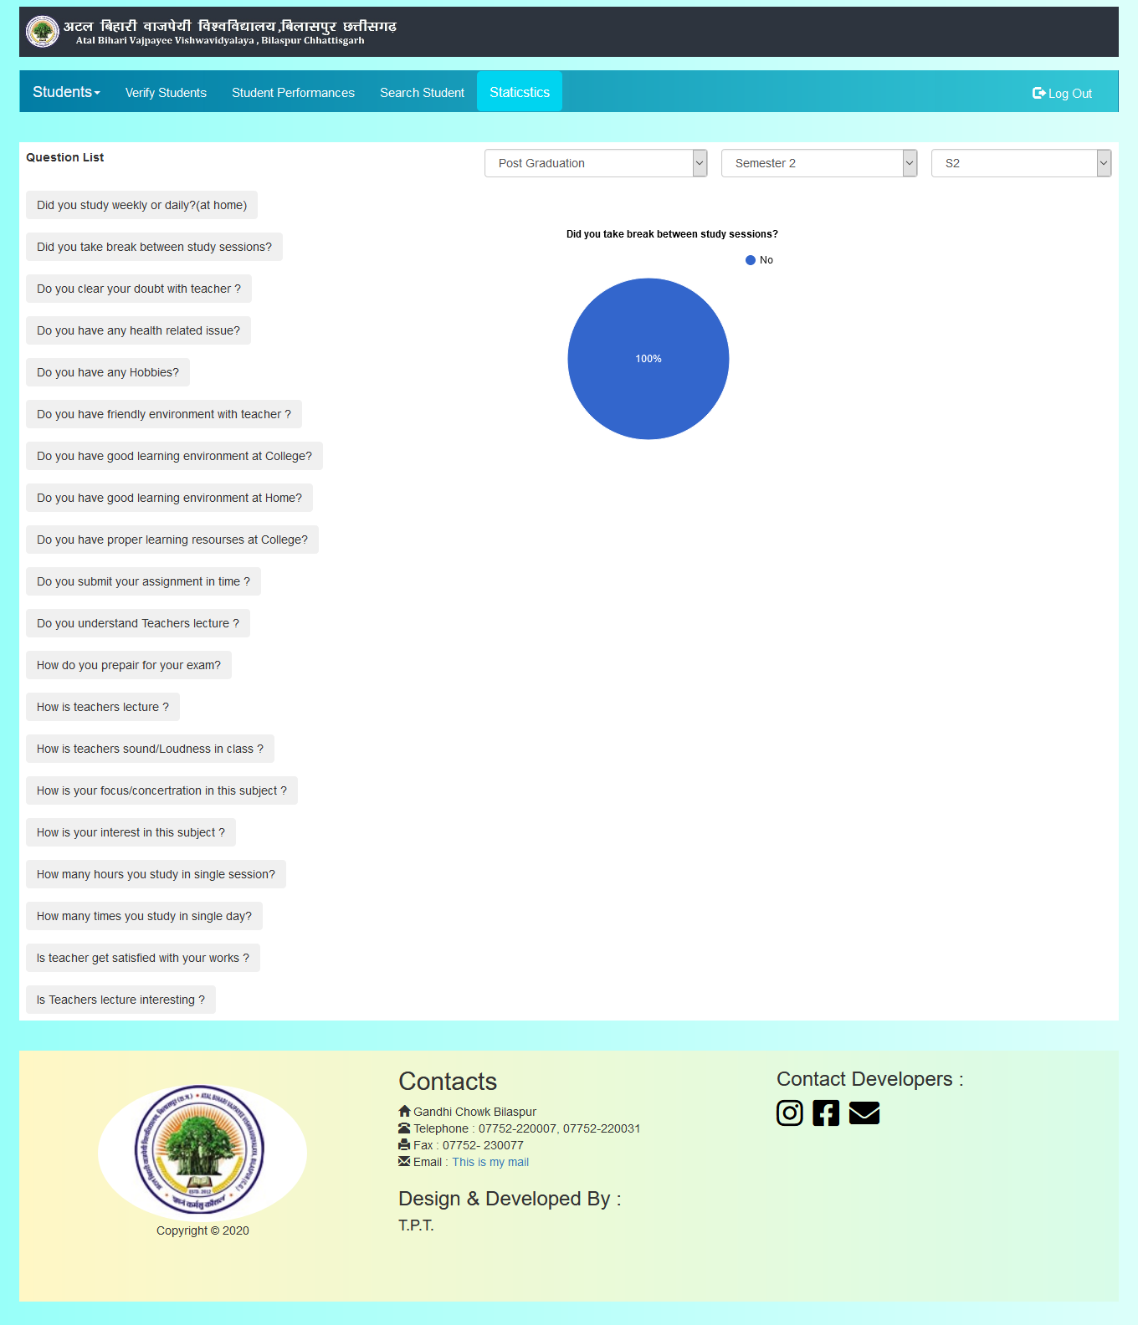
Teacher’s Statistics Snap Shot
2
+

Slide 34
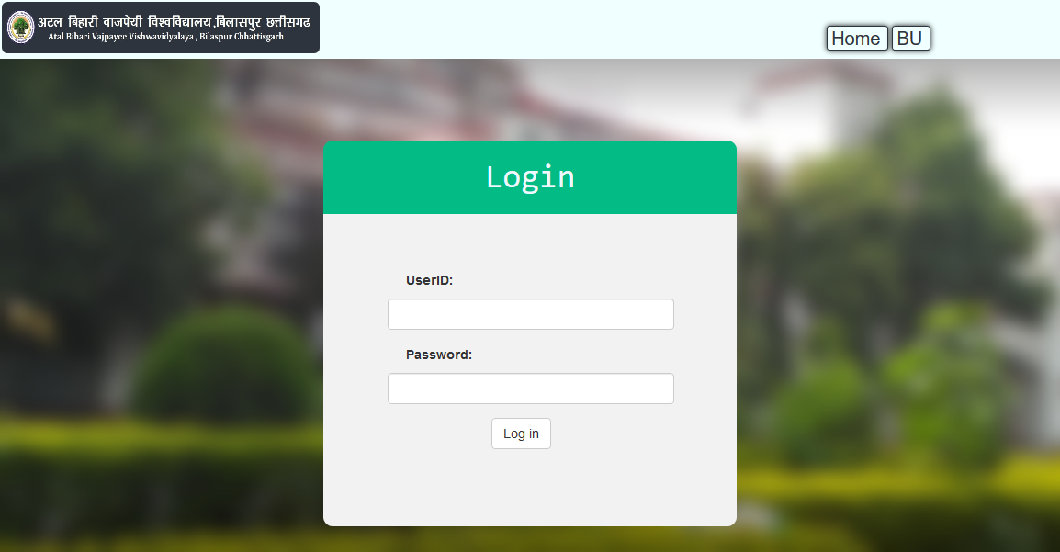
Admin Login Page Snap Shot
2
+

Slide 35
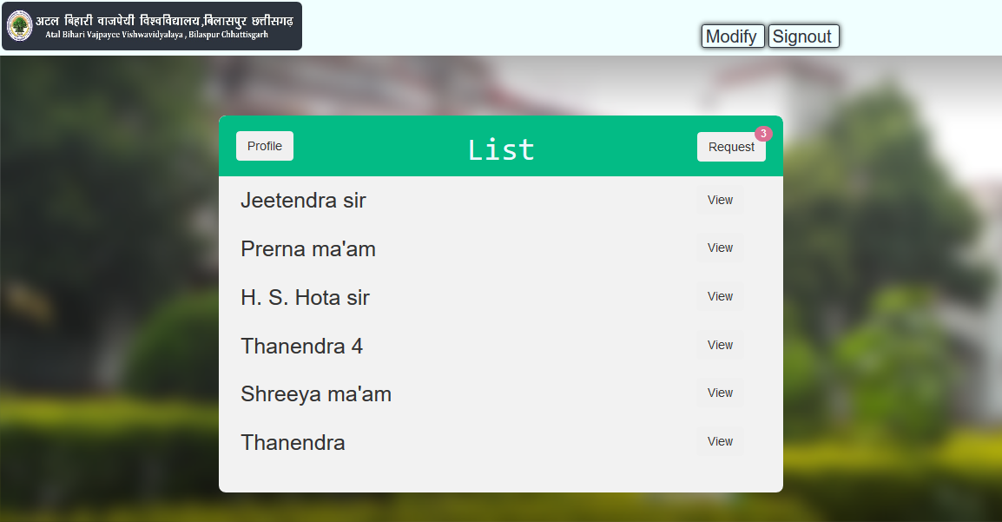
Admin – HOD List Page Snap Shot
2
+

Slide 36
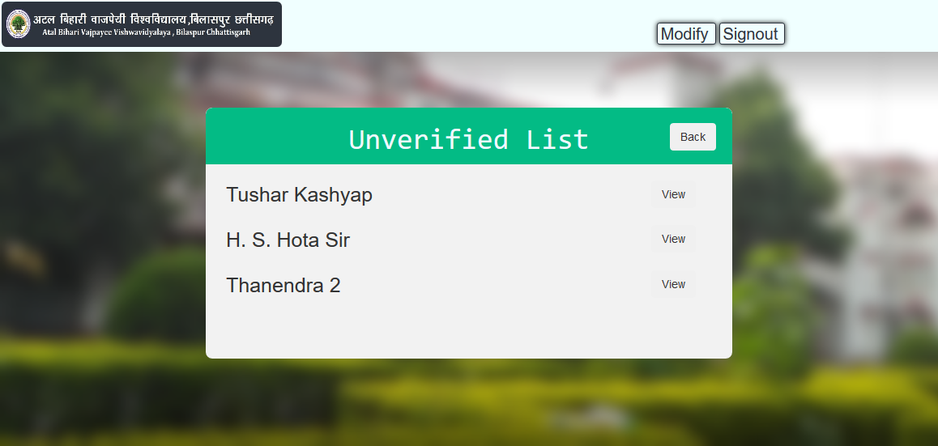
Admin – Unverified HOD Page Snap Shot
2
+

Slide 37

THANK YOU
2
+
2
+

